Slide 1
AP Biology
INTRODUCTION

Slide 2
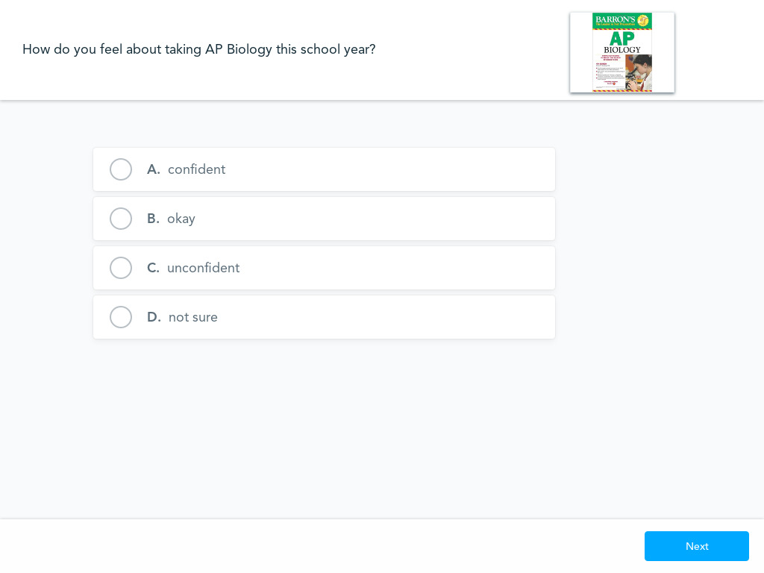
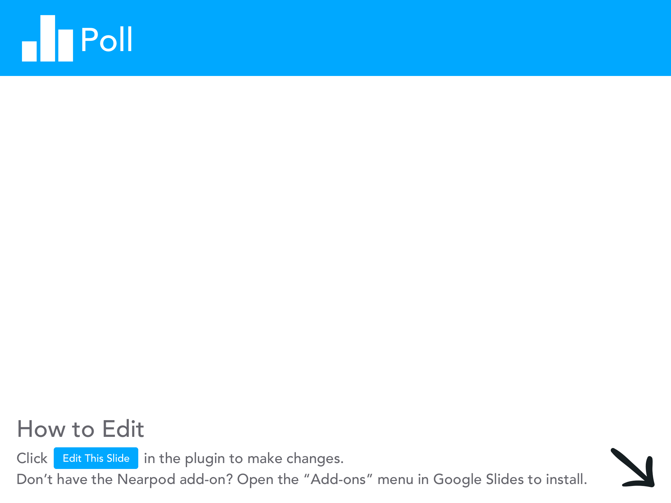

Slide 3

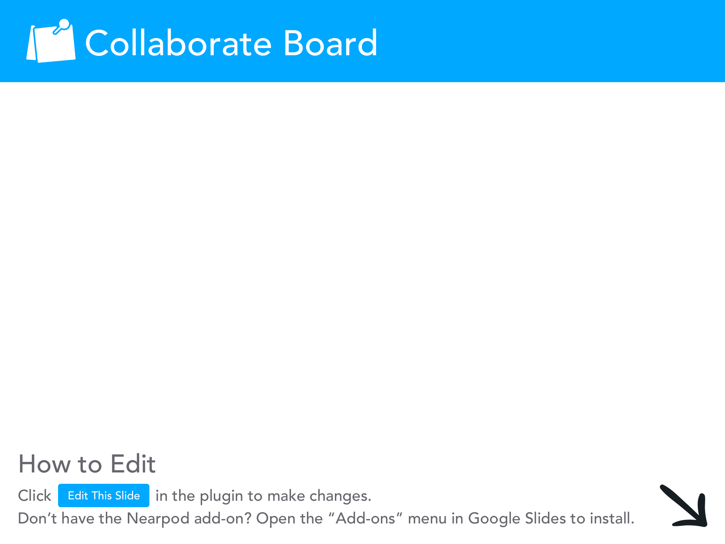

Slide 4
AP Biology Curriculum Framework
There are 4 Big Ideas:
  Evolution
  Energetics
  Information Storage and Transmission
  System Interactions

Slide 5
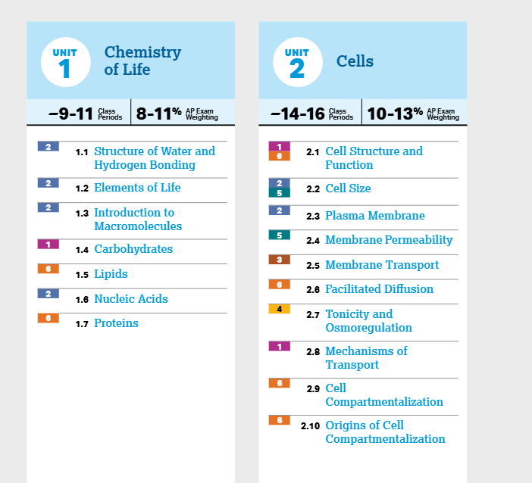
AP Biology Units

Slide 6
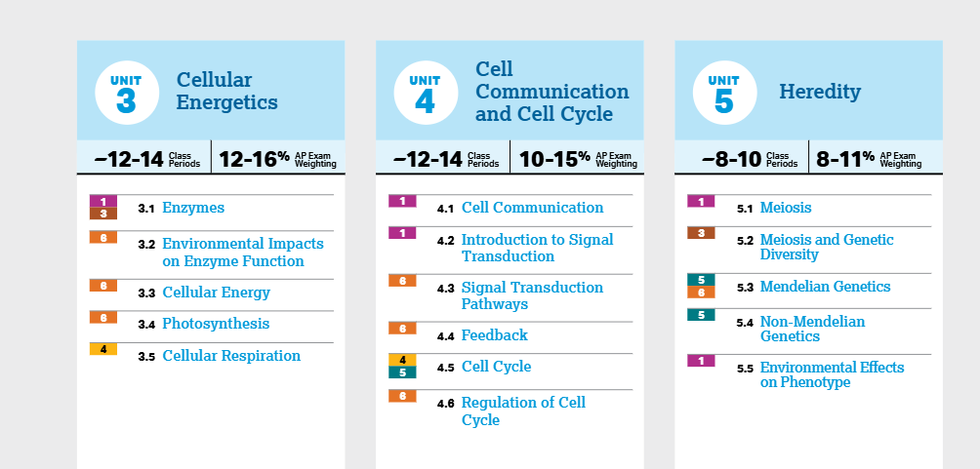
AP Biology Units

Slide 7
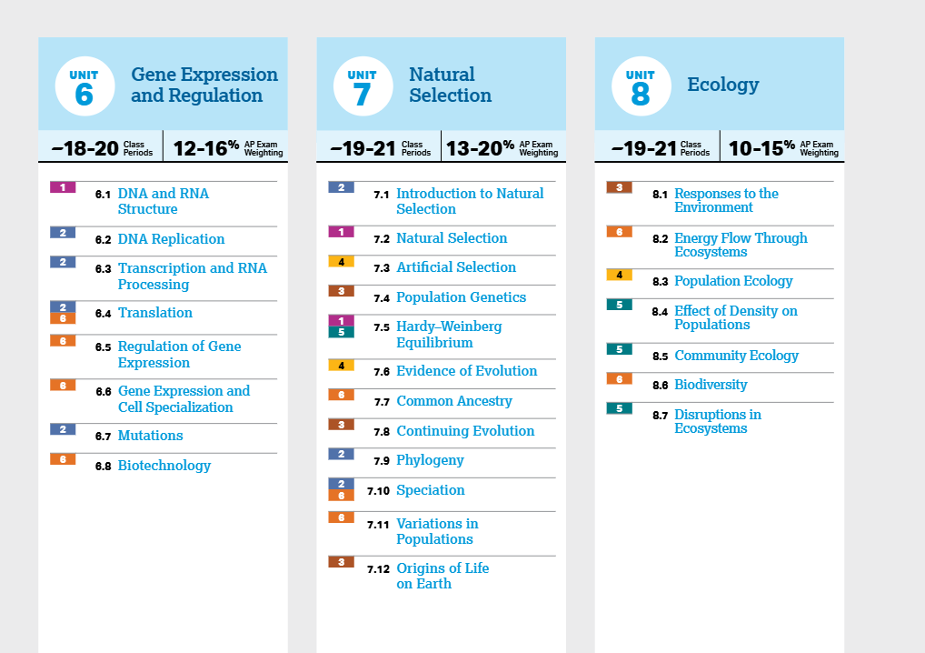
AP Biology Units

Slide 8
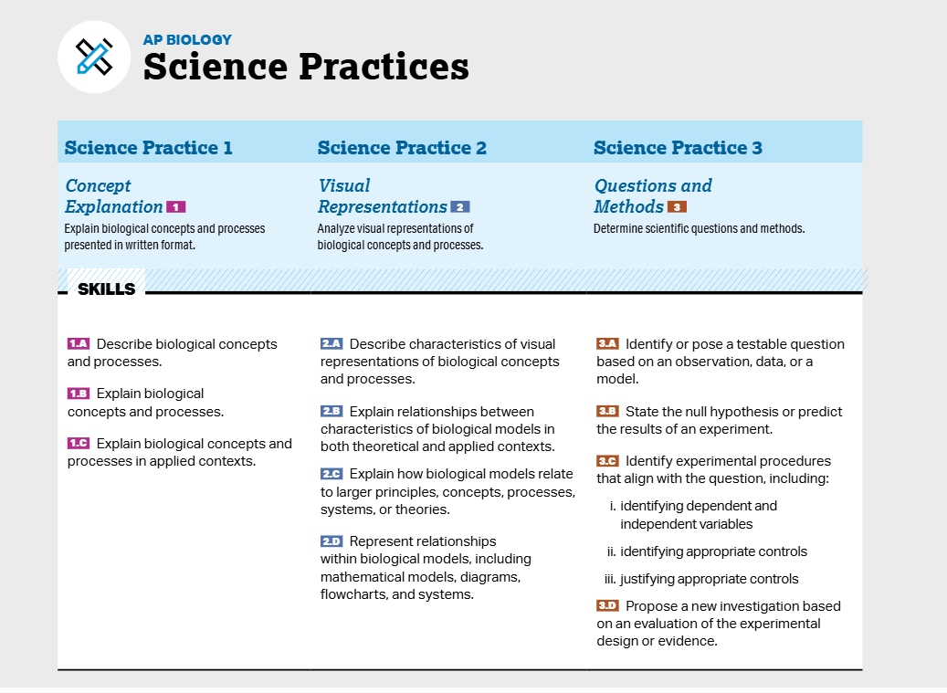

Slide 9
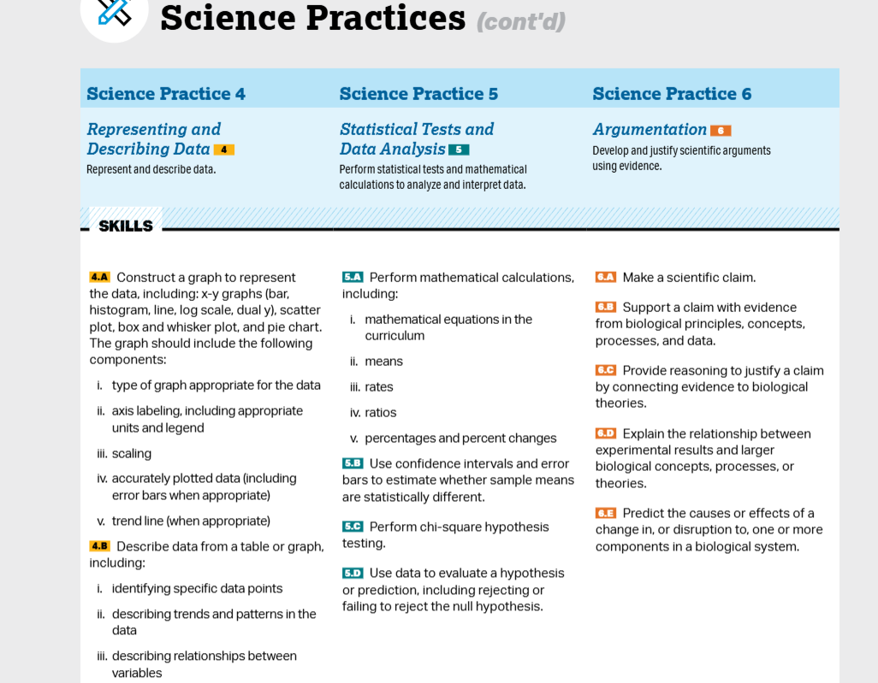

Slide 10
AP Score Distribution
AP Score | Recommendation
5 | Extremely well qualified
4 | Well qualified
3 | Qualified
2 | Possibly qualified
1 | No recommendation

Slide 11
AP Biology Exam Format
The first part of the exam is 90 minutes and it is worth 50% of the total score.
60 multiple-choice questions
The second part of the exam is 90 minutes and it is worth 50% of the total score.
2 long free response
4 short free response
Question 1: Interpreting and Evaluating Experimental Results (8–10 pts)
Question 2: Interpreting and Evaluating Experimental Results with
Graphing (8–10 pts)
Question 3: Scientific Investigation (4 pts)
Question 4: Conceptual Analysis (4 pts) Question 5: Analyze Model or
Visual Representation (4 pts)
Question 6: Analyze Data (4 pts)

Slide 12
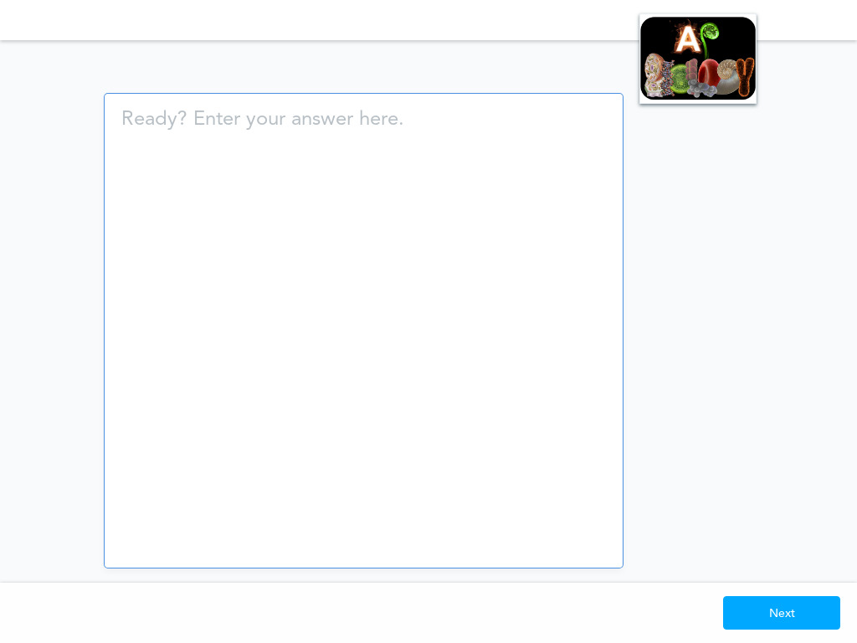
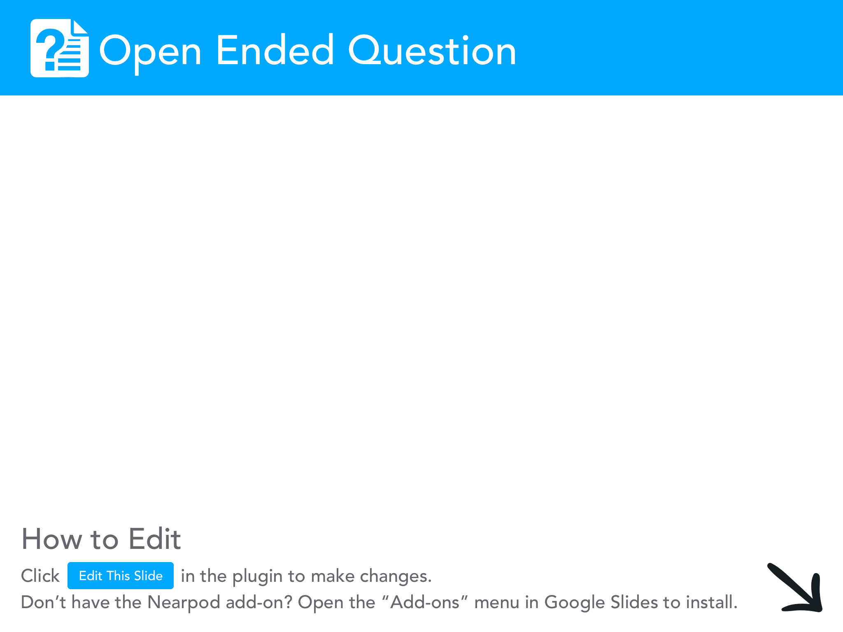

Slide 13
AP Biology Exam Format
The whole test takes 180 minutes (3 hours) to complete.
You are allowed to use the following for the exam:
a) four-function calculator, scientific calculator, and
graphing calculator (no longer needed)
b) formula sheet

Slide 14
Multiple-Choice Section
The multiple-choice section is based on the following units and their weights:
Unit | Exam Weighting
1. Chemistry of Life | 8 - 11%
2. Cell Structure and Function | 10-13%
3. Cellular Energetics | 12-16%
4. Cell Communication and Cell Cycle | 10-15%
5. Heredity | 8-11%
6. Gene Expression and Regulation | 12-16%
7. Natural Selection | 13-20%
8. Ecology | 10-15%

Slide 15
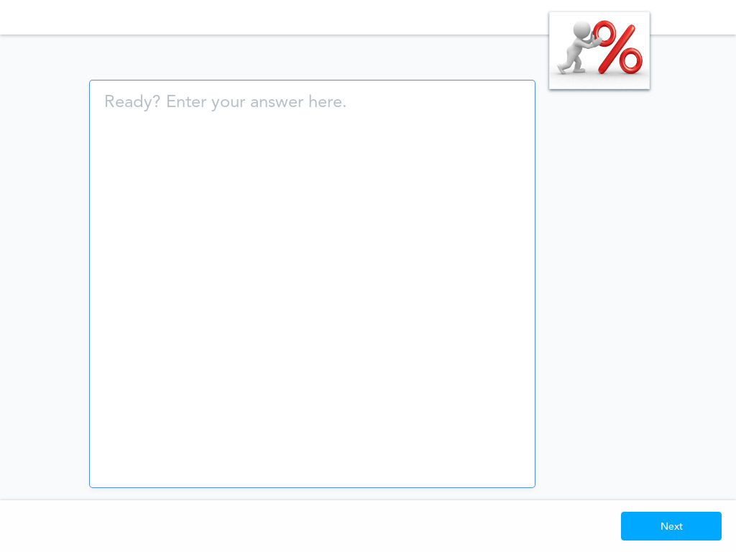

Slide 16
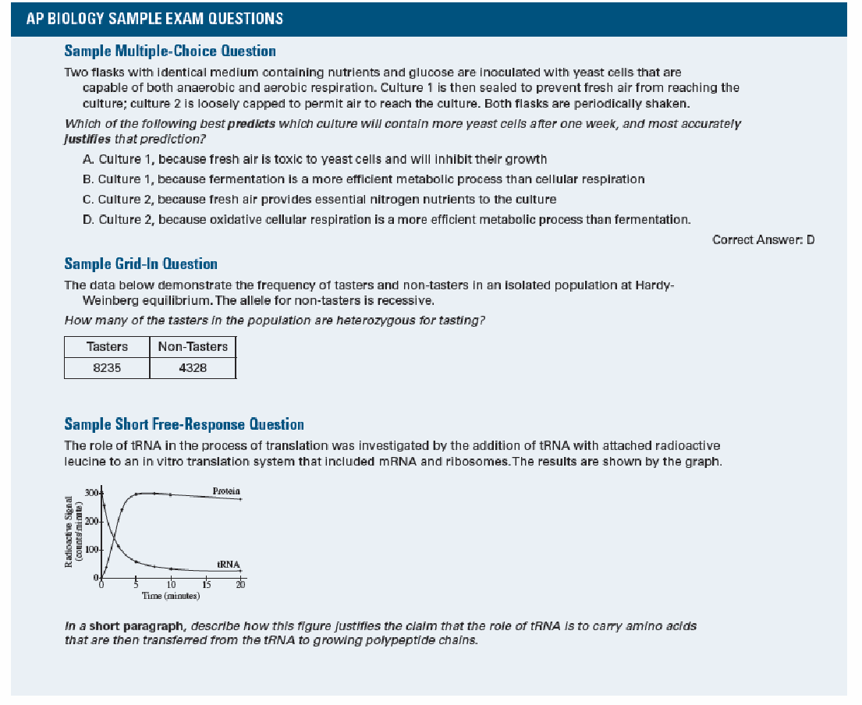
Sample Exam Questions

Slide 17
AP Biology Exam Format
Section I
Question Type | Number of Questions | Timing
Part A: Multiple Choice | 60 | 90 minutes
Section II
Question Type (Part B) | Number of Questions | Timing
Long Free Response | 2 | 90 minutes
Short Free Response | 4

Slide 18
AP Biology Labs
There are 13 AP biology labs.
1. Artificial Selection
2. Mathematical Modeling: Hardy-Weinberg
3. Comparing DNA Sequences To
Understand Evolutionary Relationships
With Blast
4. Diffusion And Osmosis
5. Photosynthesis

Slide 19
AP Biology Labs
6. Cellular Respiration
7. Cell Division: Mitosis And Meiosis
8. Biotechnology: Bacterial Transformation
9. Biotechnology: Restriction Enzyme
Analysis of DNA
10. Energy Dynamics
11. Transpiration
12. Fruit Fly Behavior
13. Enzyme Activity

Slide 20
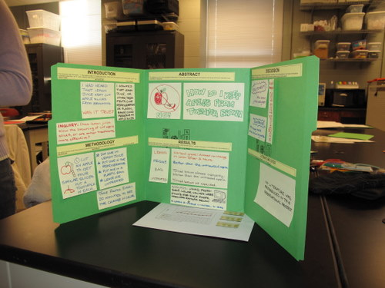
AP Biology Labs
Each of the labs involve INQUIRY and the 6 science practices.
Some of the labs will be in the following format:
Written
Poster Board
Formal Lab Report Format
A good lab report format includes six
main sections:
Title
Introduction
Materials and Methods
Results
Conclusion
References

Slide 21
What is the Exam Date for AP Biology?
Monday, May 4, 2026 at 8:00 a.m.

Slide 22
